Slide 1
Customer churn analysis for Telecom industry

Slide 2
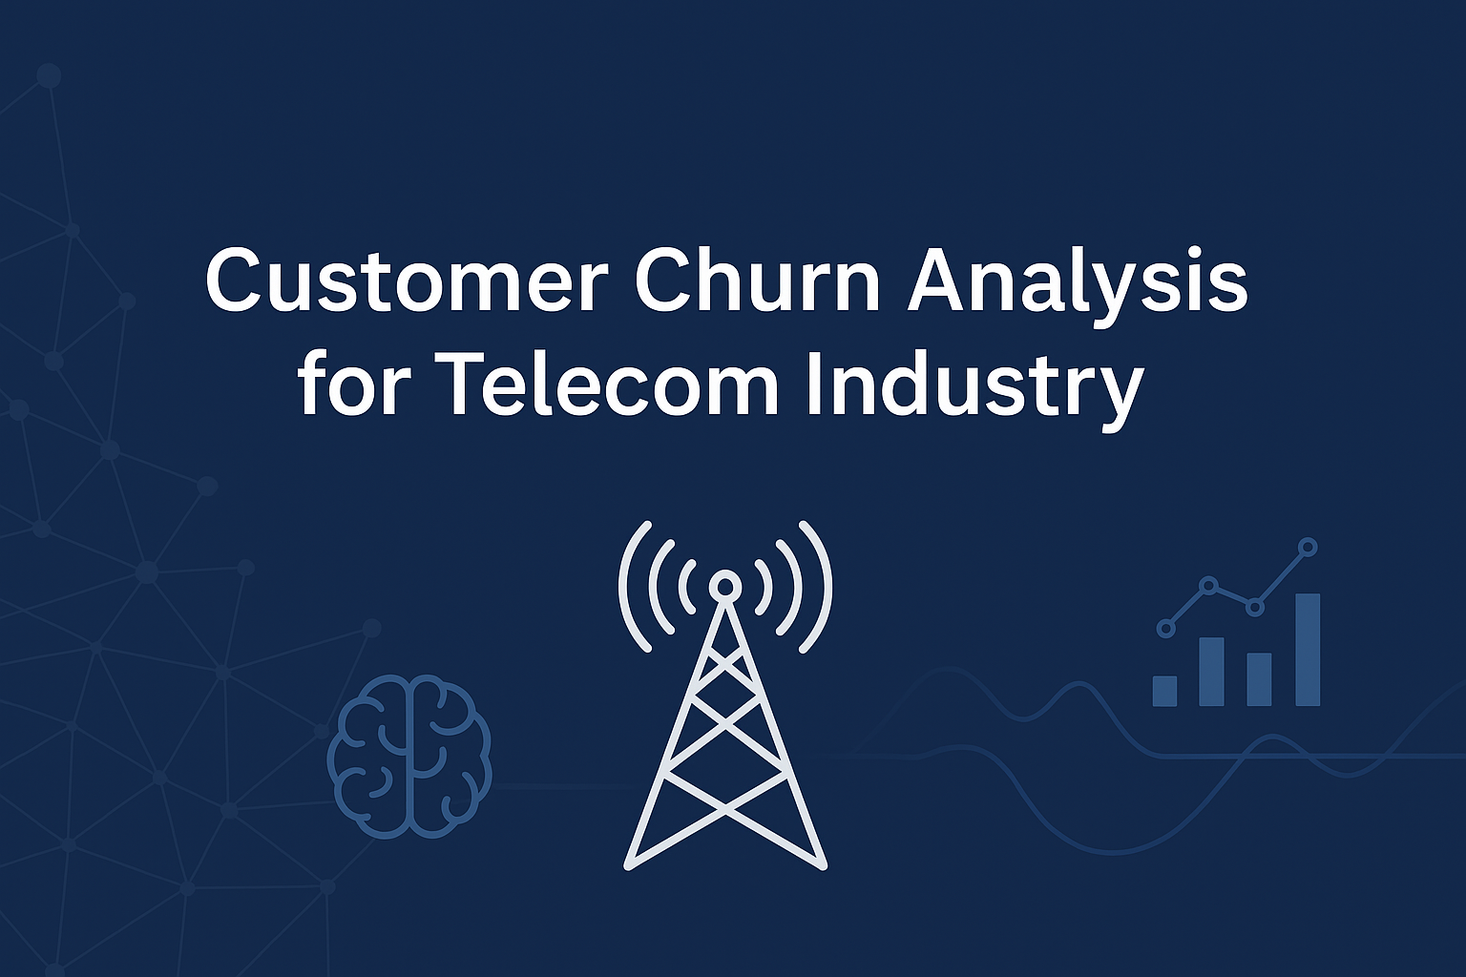
introduction
Customer churn = % of customers leaving within a time frame
Retaining customers is more cost-effective than acquiring new ones
Goal → Predict churn & identify at-risk customers
Enable proactive actions: discounts, loyalty offers, personalized plans

Slide 3
Abstract | Tools Used | Project Workflow
SQL → Preprocessing & aggregation Python (Scikit-learn) → Churn classification model Explainability (ELI5) → Key churn drivers Segmentation → At-Risk, Loyal, Dormant groups | SQL → Data cleaning & aggregation Python (Pandas, Matplotlib, Scikit-learn) → Modeling & visualization ELI5 → Model explainability Jupyter Notebook → Development environment | Steps: Data Loading & SQL Preprocessing Model Building (Classification) Model Evaluation Model Explainability Customer Segmentation Business Recommendations

Slide 4
Data preprocessing
Imported dataset into SQL & Pandas
Handled missing values (e.g., TotalCharges)
Encoded categorical variables (Contract, PaymentMethod)
Aggregated by customerID for uniqueness

Slide 5
Model building
Train-test split: 70-30
Models used:
Logistic Regression (baseline)
Random Forest / XGBoost (improved performance)

Slide 6
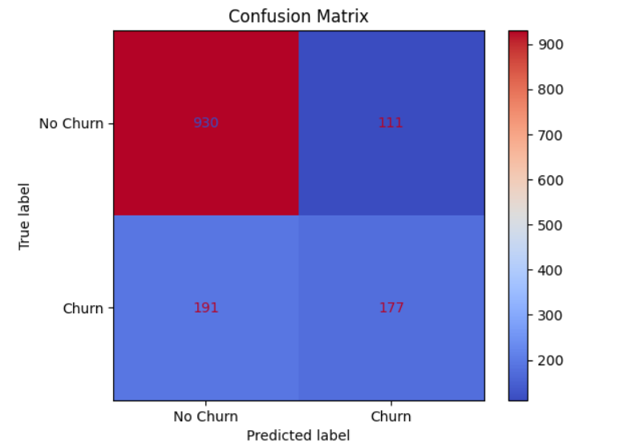

Model evaluation
Metrics: Accuracy, Precision, Recall, F1-score, ROC-AUC
Confusion Matrix → Focus on False Negatives (missed churners = costly)

Slide 7
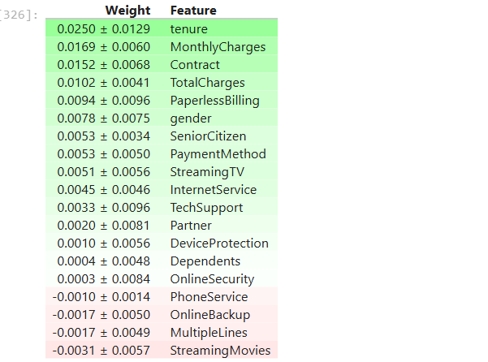
Model explainability
Used ELI5 for feature importance Key insights:
Month-to-month contracts → High churn
High monthly charges → Higher churn
Low tenure → Higher churn probability

Slide 8
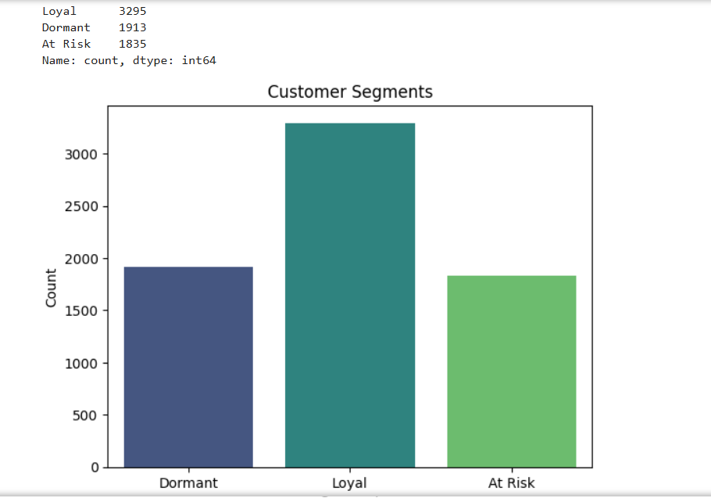
Customer segment
At-Risk → High probability of churn
Loyal → Long tenure, low churn probability
Dormant → Inactive / low service usage

Slide 9
conclusion
Churn is highest among month-to-month, high-cost customers without add-on services. Focused retention efforts can cut revenue loss and improve customer loyalty.
Churn control today ensures profitability tomorrow.

Slide 10
THANK YOU

